Slide 1
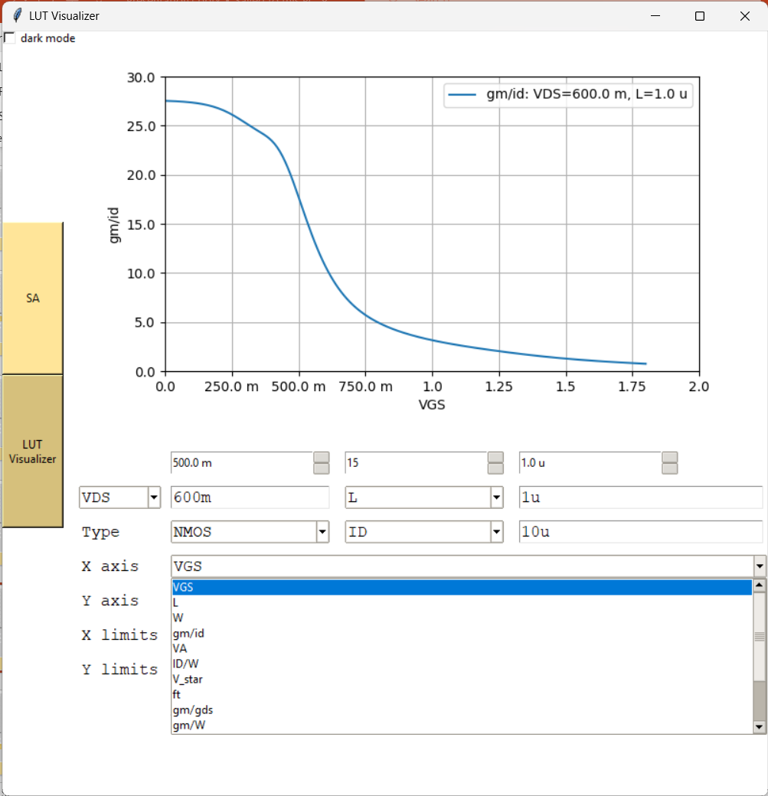
LUT Visualizer (for intuitiveness)
You can plot whatever you want
vs whatever you want

Slide 2
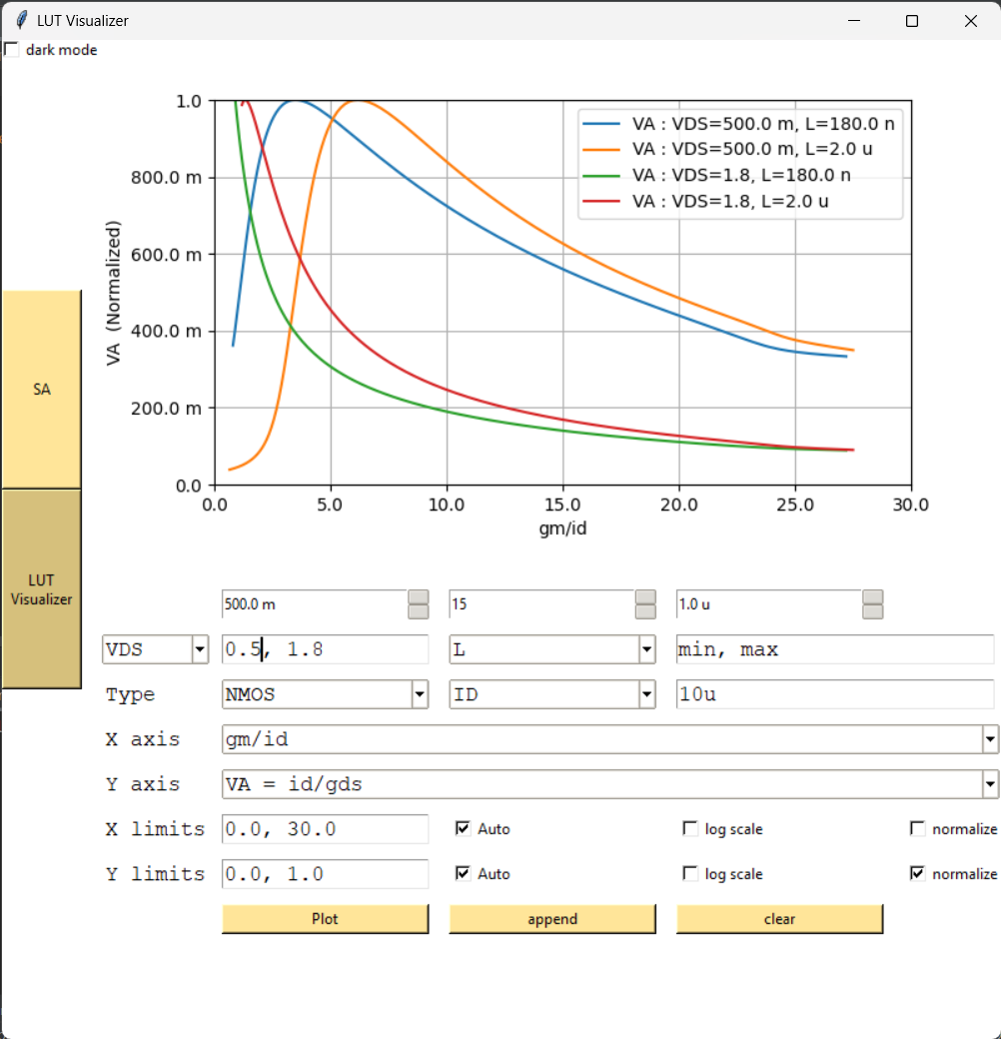
LUT Visualizer (for intuitiveness)
You can select from the pop-up menu
Or type any expression you want
You can also plot multiple sweeps, normalize, and change the limits of the plot

Slide 3
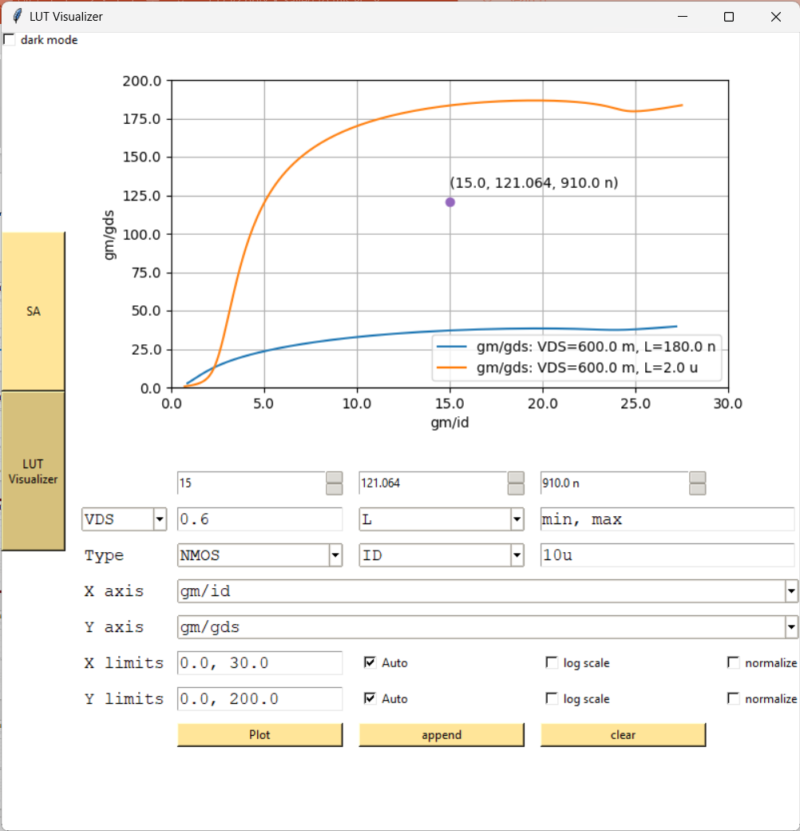
LUT Visualizer (for intuitiveness)
You can also search for a point

Slide 4
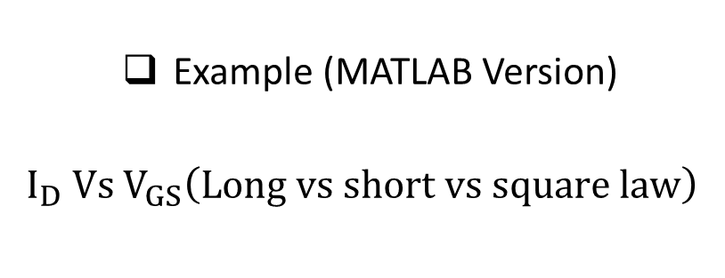
LUT Visualizer (for intuitiveness)
Example (MATLAB Version)
$$I_{D} Vs V_{GS}\left(Long vs short vs square law\right)$$
GD link of the Tool

Slide 5
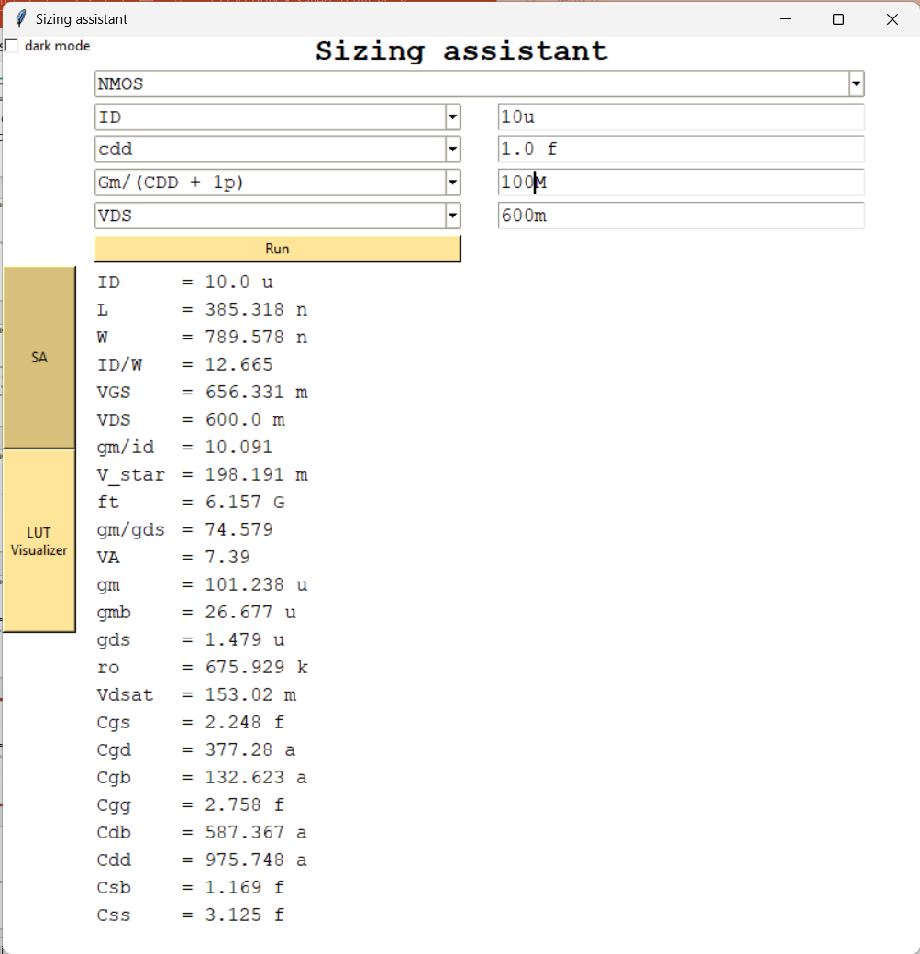
Sizing assistant
You can get complete sizing given any 2 parameters and (ID or W)

Slide 6
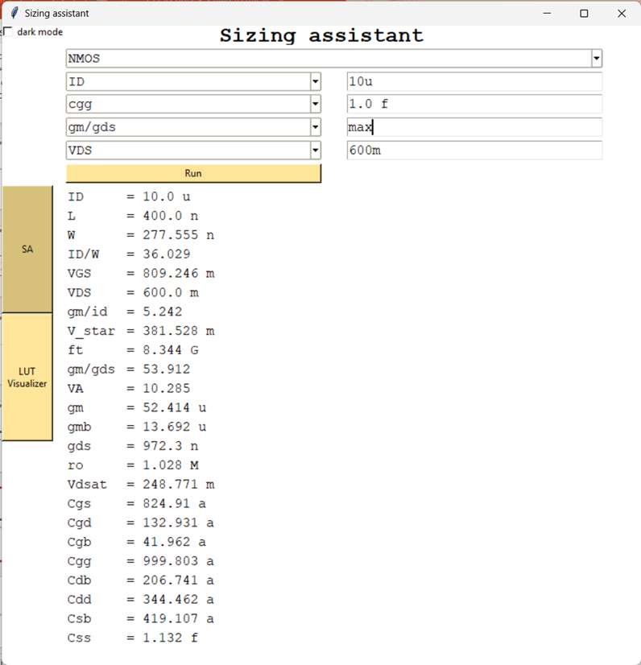
Sizing assistant
You can search for maximum and minimum points

Slide 7
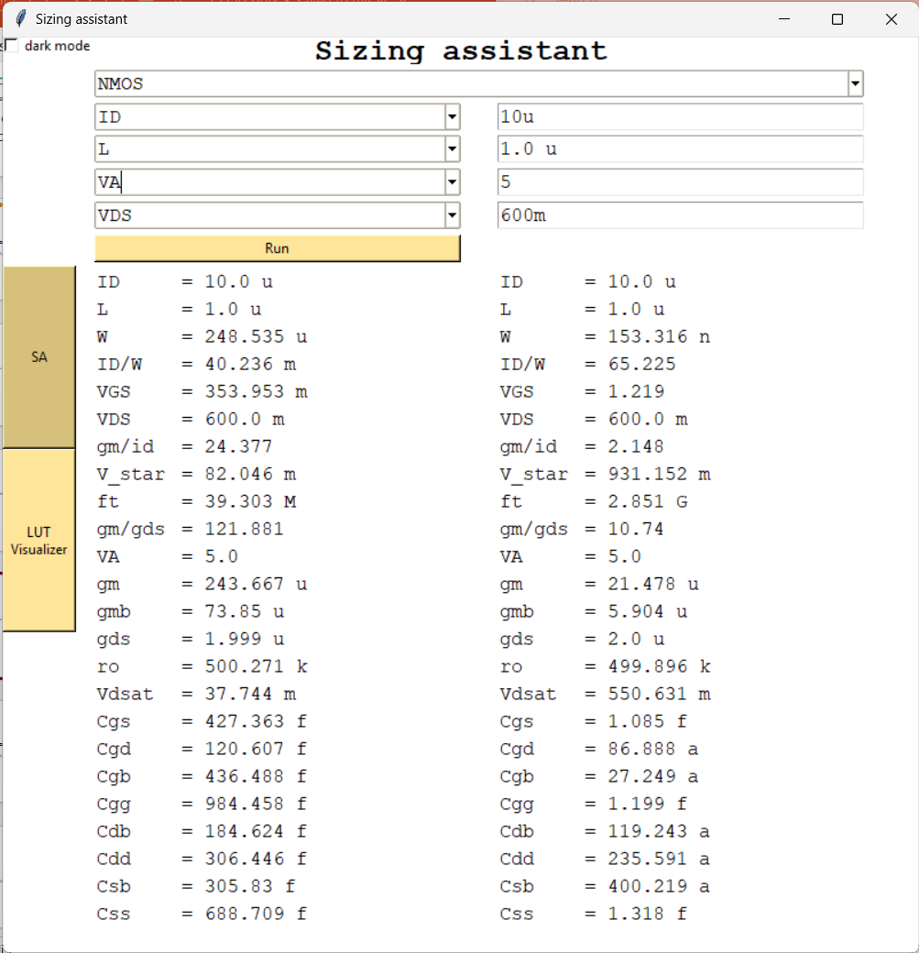
Sizing assistant
More than one valid point?

